Slide 1




X

Slide 2
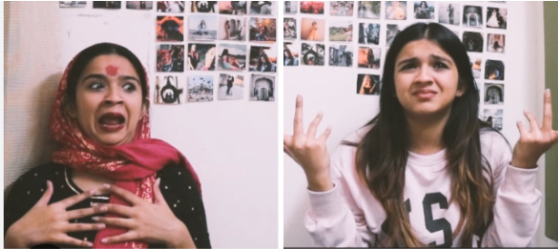
Triple Choco Croissant, Triple Drama Ft. Rebel Kid

Slide 3
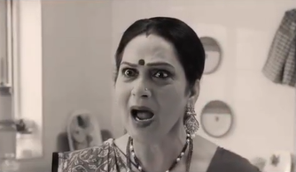
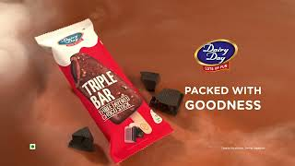
Treatment Reference

Slide 4
Script Flow

Slide 5
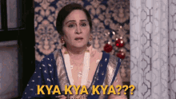
Apoorva, like a typical daily soap actress,
turns around three times in utter shock, looking into the camera

Slide 6


Camera zooms out and we see Apoorva holding a Triple Choco Croissant pack.
“Ismein teen..teen..teen…choco layers hain?”

Slide 7
Product Window opens up with three layers of chocolate appearing on the screen in a romantic way.
“Gooey choco cream, so soft choco bread…and ooh…yummy choco chips!”

Slide 8
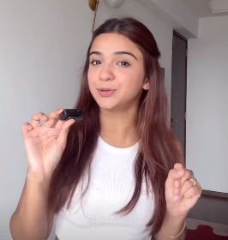
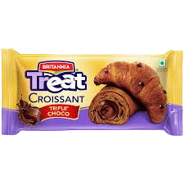
Triple Choco Croissant is formed; transitions to Apoorva taking a biiiiig bite of the croissant.
“Jab Triple Choco croissant hoga, triple drama toh hoga hi”

Slide 9
Brand Slate with packshot + logo
Brand VO: Britannia Triple Choco Croissant Apoorva’s VO: Try now, now, now!

Slide 10
Fin.

